Slide 1
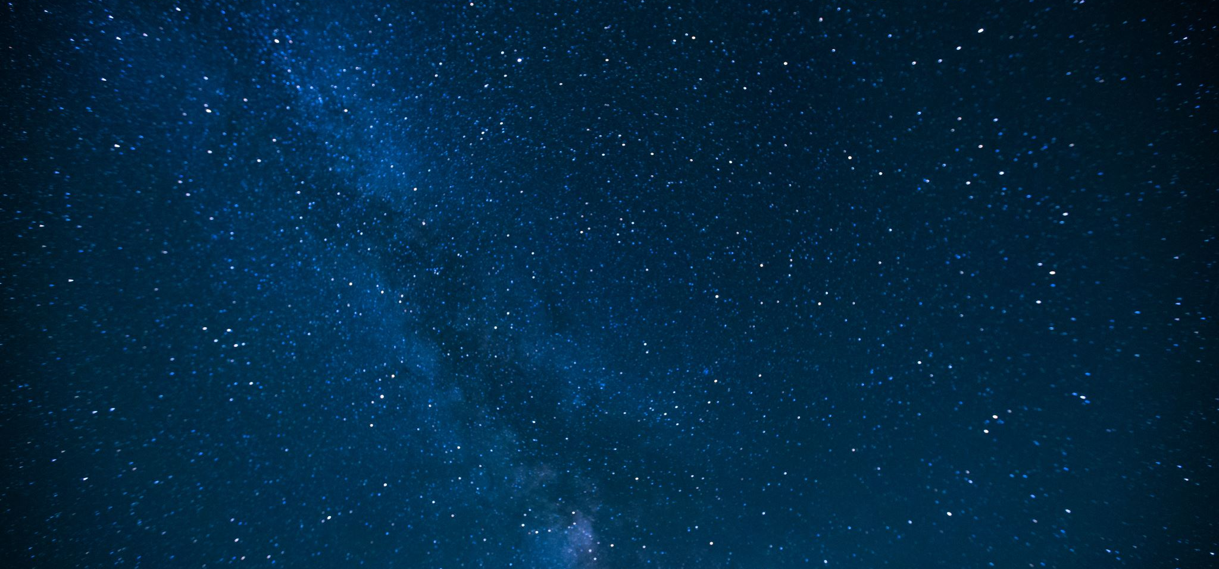


Astronomical Interferometry Professor Mauro D’Onofrio
Adriana Barbieri
Master Degree in Astrophysics and Cosmology
University of Padova
16/09/2022
A. Y. 2021/2022

Slide 2


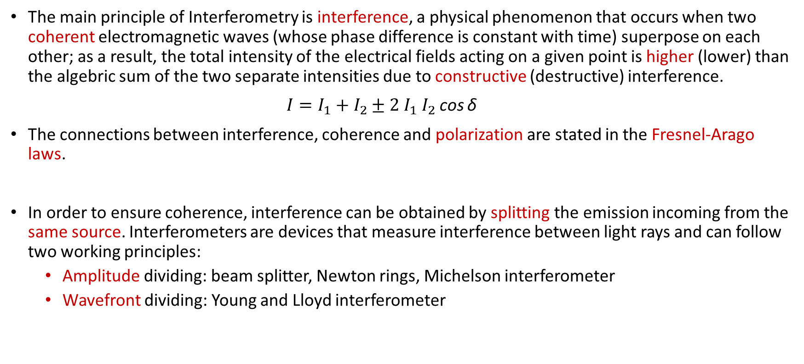
What is Interferometry?
The main principle of Interferometry is interference, a physical phenomenon that occurs when two coherent electromagnetic waves (whose phase difference is constant with time) superpose on each other; as a result, the total intensity of the electrical fields acting on a given point is higher (lower) than the algebric sum of the two separate intensities due to constructive (destructive) interference.
$I=I_{1}+I_{2}±2 I_{1}{ I}_{2}$ cos δ
The connections between interference, coherence and polarization are stated in the Fresnel-Arago laws.
In order to ensure coherence, interference can be obtained by splitting the emission incoming from the same source. Interferometers are devices that measure interference between light rays and can follow two working principles:
Amplitude dividing: beam splitter, Newton rings, Michelson interferometer
Wavefront dividing: Young and Lloyd interferometer

Slide 3
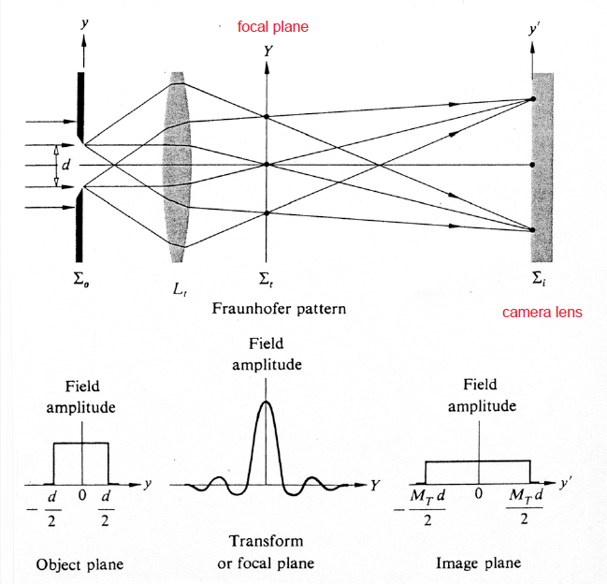
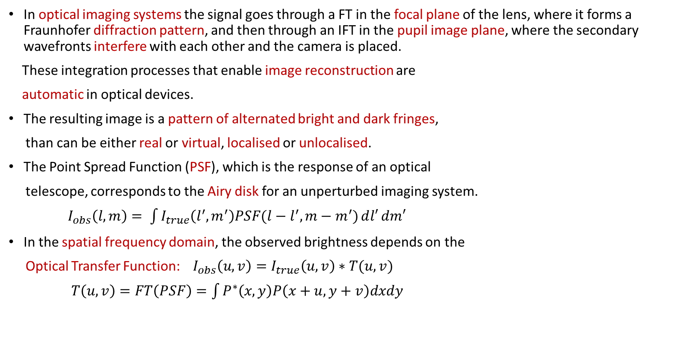
Optical Interference
In optical imaging systems the signal goes through a FT in the focal plane of the lens, where it forms a Fraunhofer diffraction pattern, and then through an IFT in the pupil image plane, where the secondary wavefronts interfere with each other and the camera is placed.
These integration processes that enable image reconstruction are
automatic in optical devices.
The resulting image is a pattern of alternated bright and dark fringes,
than can be either real or virtual, localised or unlocalised.
The Point Spread Function (PSF), which is the response of an optical
telescope, corresponds to the Airy disk for an unperturbed imaging system.
$I_{obs}\left(l,m\right)= \int{I_{true}\left(l^{′},m^{′}\right)PSF(l−l^{′},m−m^{′})ⅆl′}dm′$
In the spatial frequency domain, the observed brightness depends on the
Optical Transfer Function: ${ I}_{obs}\left(u,v\right)=I_{true}\left(u,v\right)∗T(u,v)$
$T\left(u,v\right)=FT\left(PSF\right)=\int{P^{∗}\left(x,y\right)P\left(x+u,y+v\right)dxdy }$

Slide 4
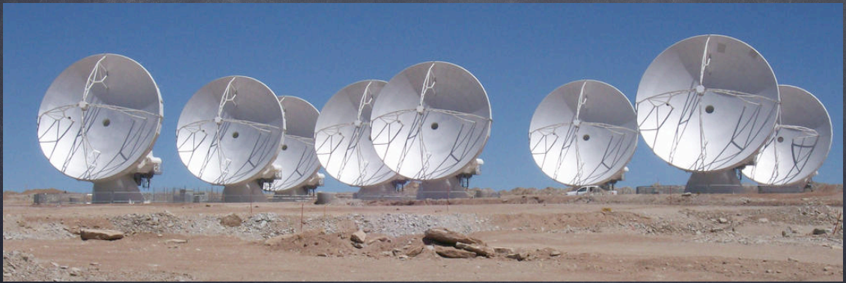
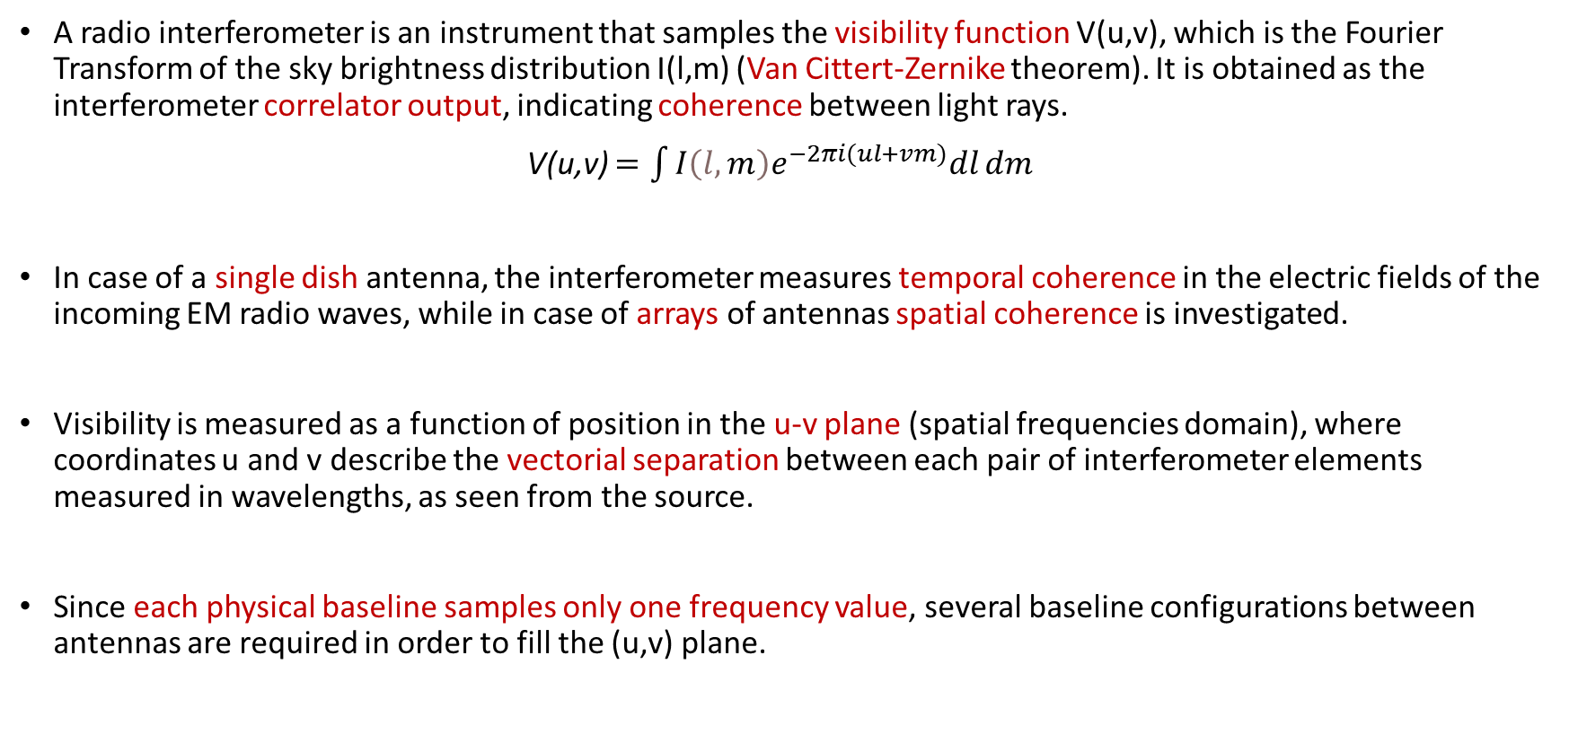
Radio Interferometry
A radio interferometer is an instrument that samples the visibility function V(u,v), which is the Fourier Transform of the sky brightness distribution I(l,m) (Van Cittert-Zernike theorem). It is obtained as the interferometer correlator output, indicating coherence between light rays.
V(u,v) $=\int{I{\left(l,m\right)e}^{−2πi(ul+vm)}dl}dm$
In case of a single dish antenna, the interferometer measures temporal coherence in the electric fields of the incoming EM radio waves, while in case of arrays of antennas spatial coherence is investigated.
Visibility is measured as a function of position in the u-v plane (spatial frequencies domain), where coordinates u and v describe the vectorial separation between each pair of interferometer elements measured in wavelengths, as seen from the source.
Since each physical baseline samples only one frequency value, several baseline configurations between antennas are required in order to fill the (u,v) plane.

Slide 5
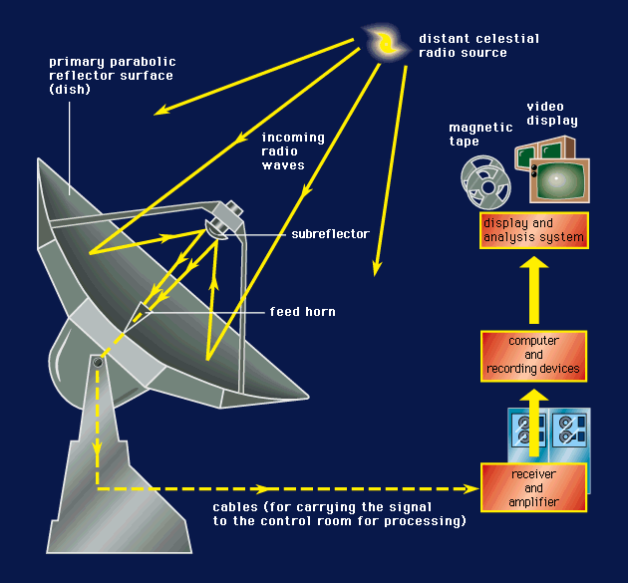
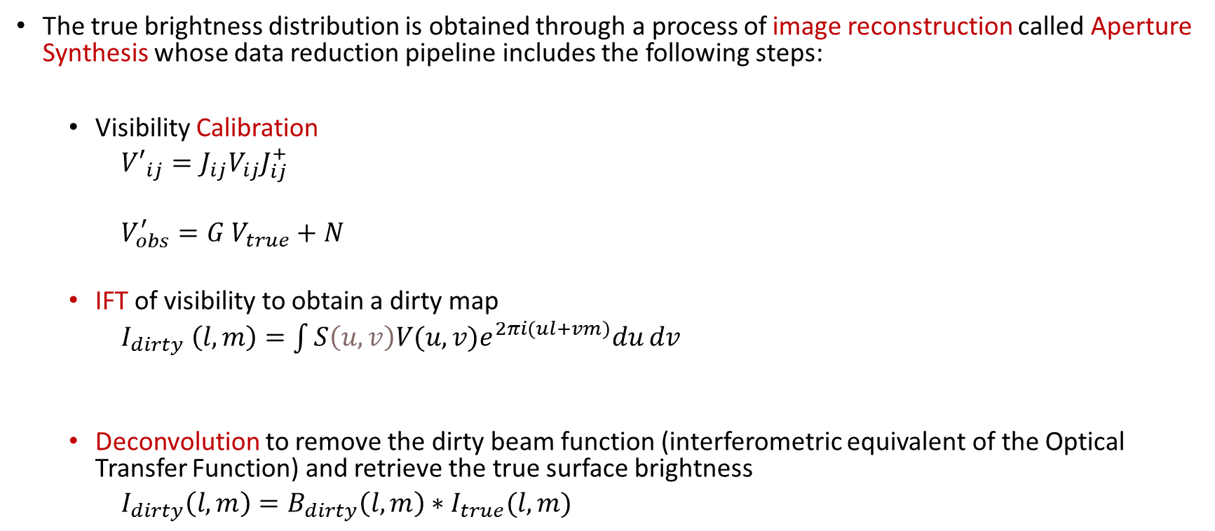
Aperture Synthesis
The true brightness distribution is obtained through a process of image reconstruction called Aperture Synthesis whose data reduction pipeline includes the following steps:
Visibility Calibration
${V′}_{ij}={J_{ij}V_{ij}J}_{ij}^{+}$
$V_{obs}^{′}=G V_{true}+N$
IFT of visibility to obtain a dirty map
$I_{dirty} \left(l,m\right)=\int{S{\left(u,v\right)V(u,v)e}^{2πi(ul+vm)}du}dv$
Deconvolution to remove the dirty beam function (interferometric equivalent of the Optical Transfer Function) and retrieve the true surface brightness
${I_{dirty}\left(l,m\right)=B}_{dirty}\left(l,m\right)∗I_{true}(l,m)$

Slide 6
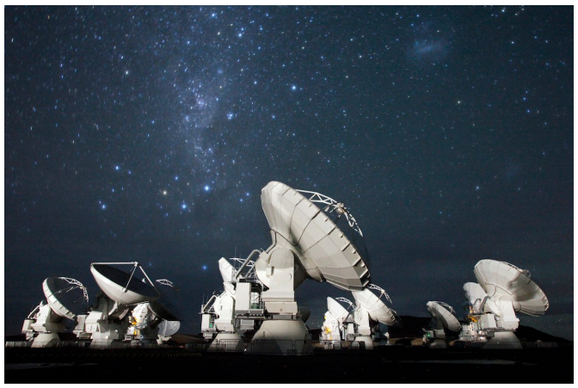
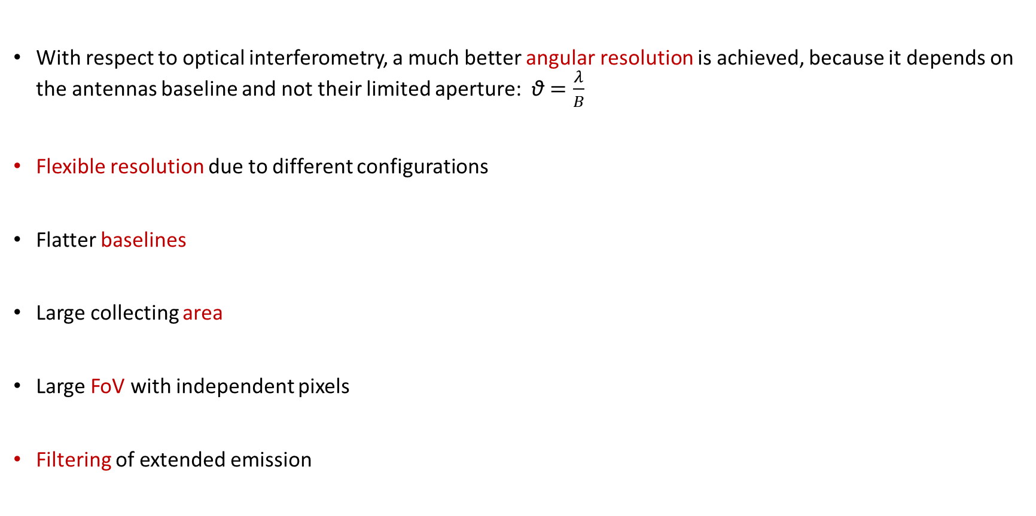
Advantages
With respect to optical interferometry, a much better angular resolution is achieved, because it depends on the antennas baseline and not their limited aperture: $\text{θ}=\frac{λ}{B}$
Flexible resolution due to different configurations
Flatter baselines
Large collecting area
Large FoV with independent pixels
Filtering of extended emission

Slide 7
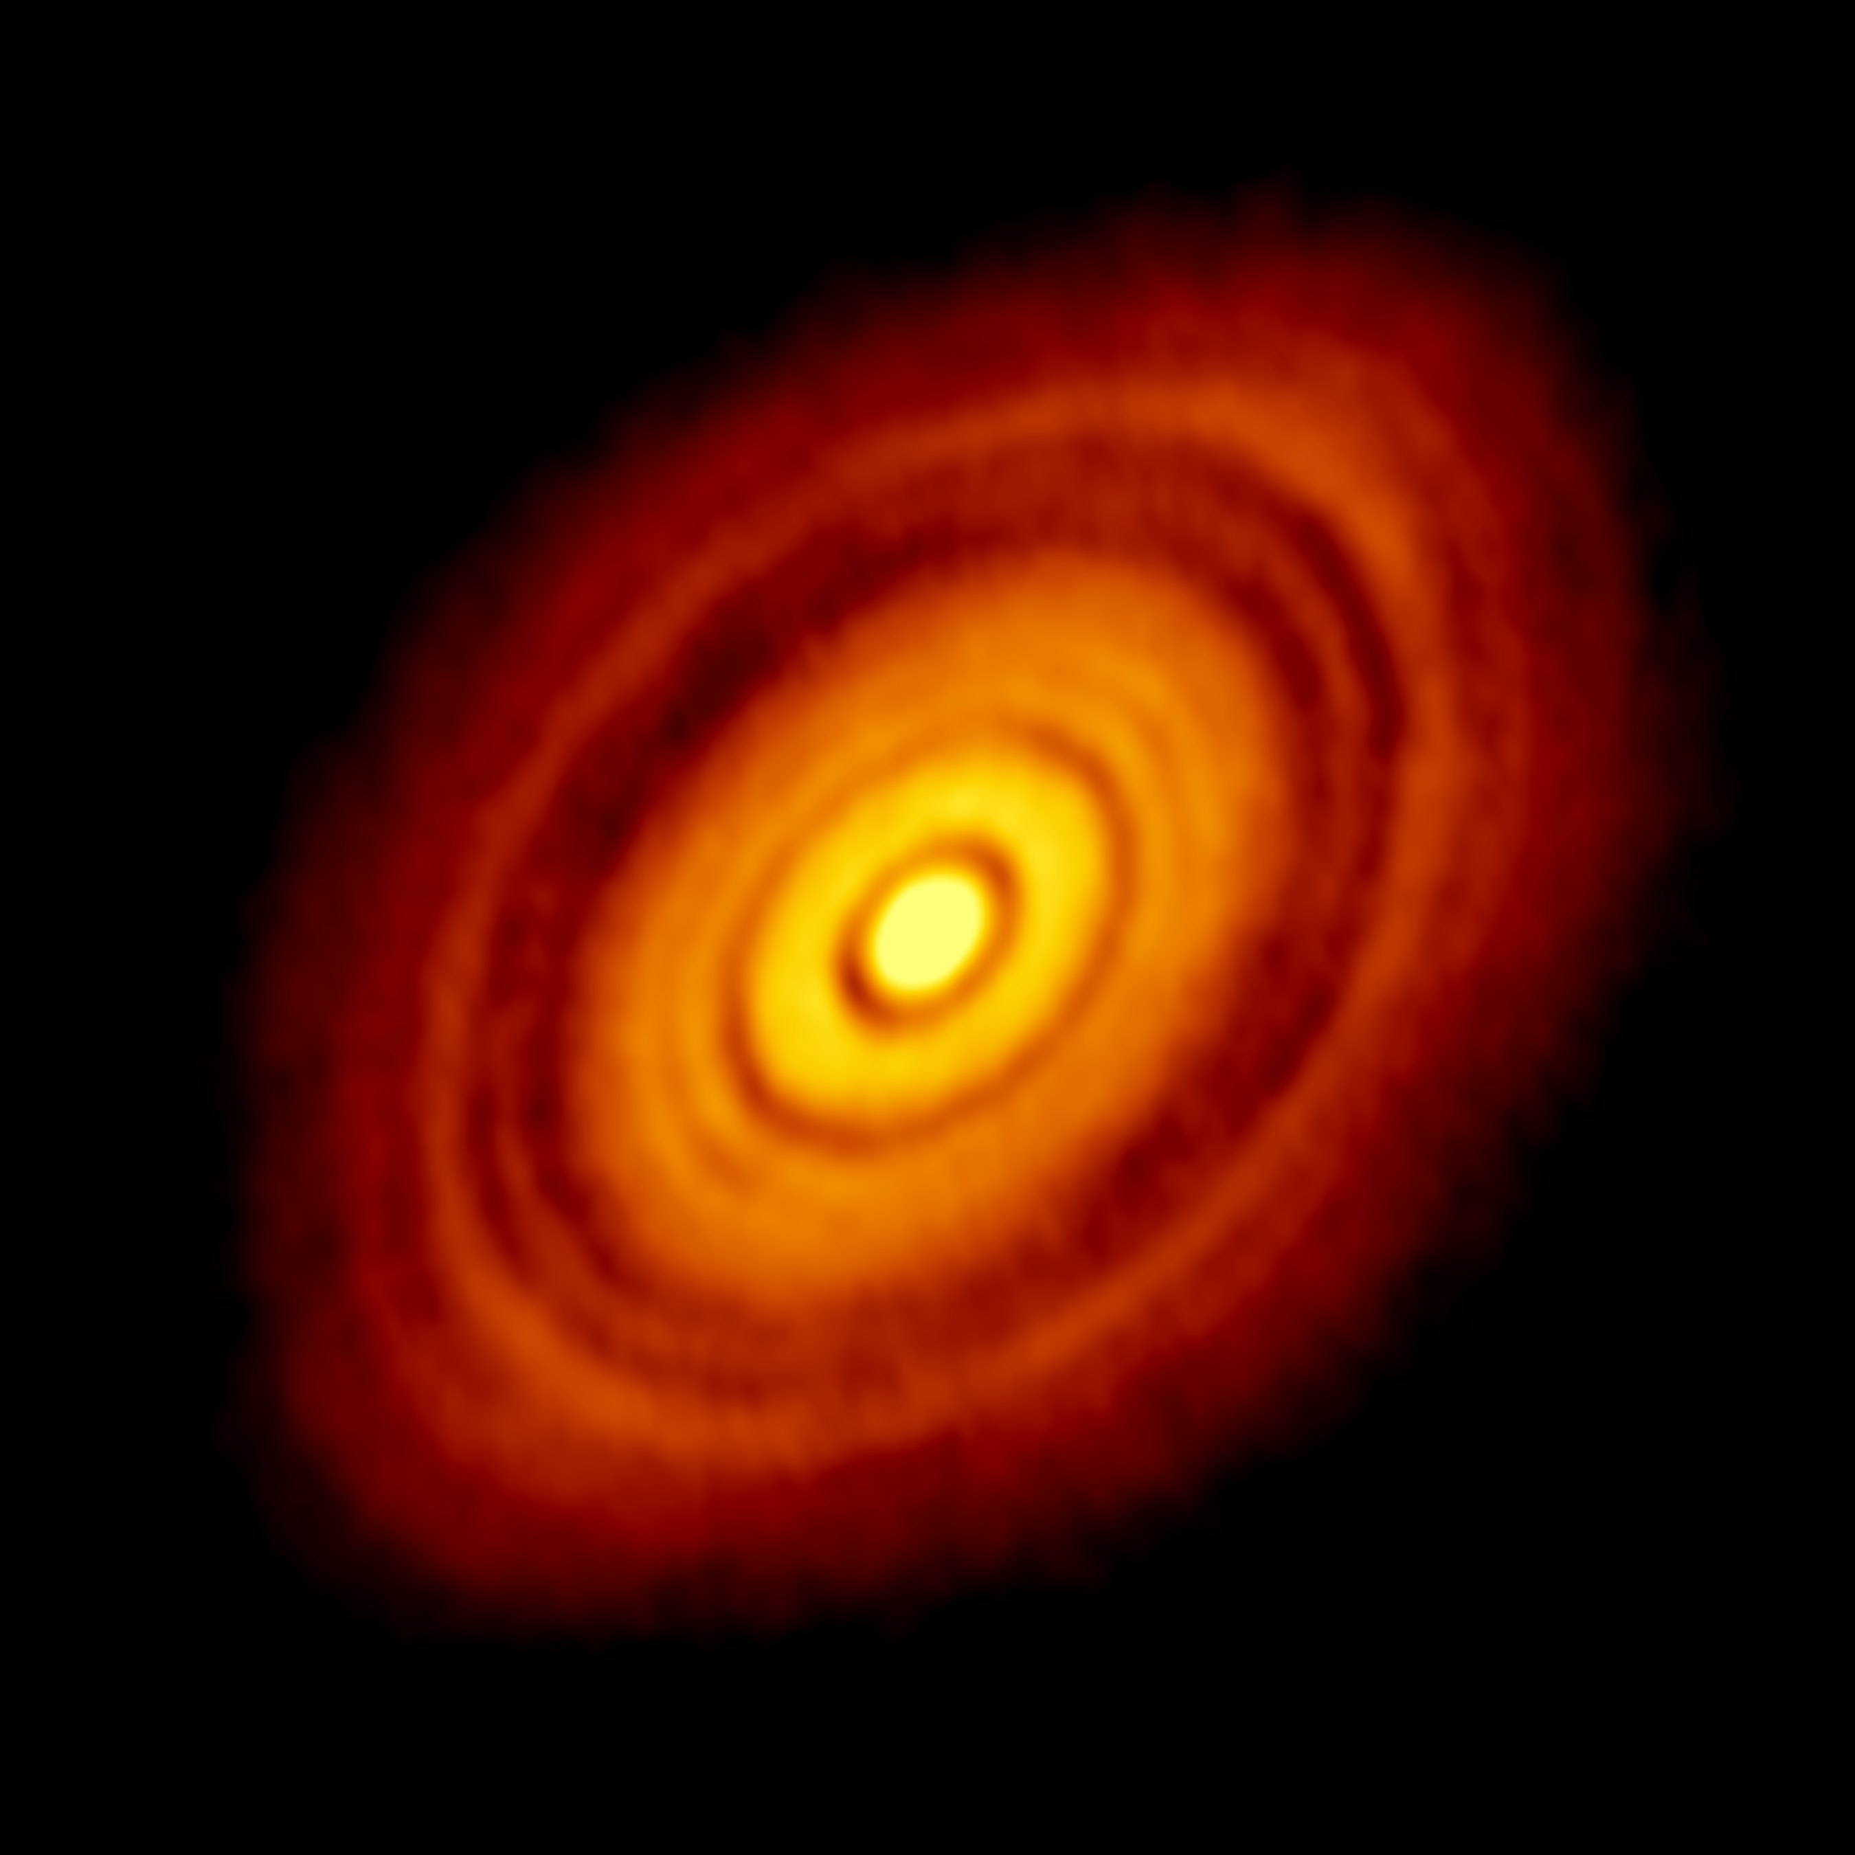
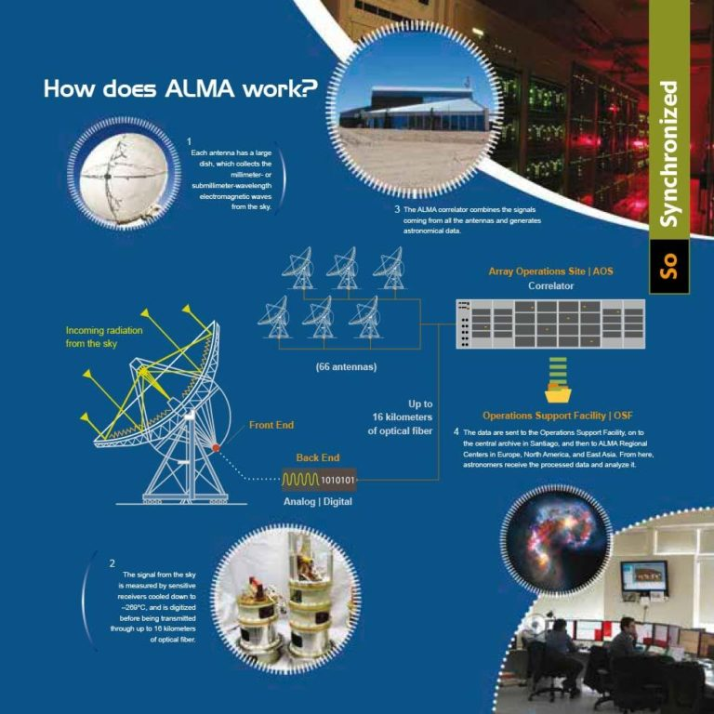
ALMA
ALMA (Atacama Large Millimiter/submillimiter Array) is a radio interferometer consisting of a large 12-m array, with antenna baselines up to 16 km, and an additional Atacama Compact Array (ACA), consisting of 12 7-m antennas and 4 12-m antennas, for a total of 66 antennas.
The ALMA antennas are located on the Chajnantor plateau of the Chilean Andes at an altitude of 5000 meters, where exceptional atmospheric conditions such as transparency and stability for observations at mm and sub-mm wavelengths can be found.
ALMA Observatory is able to achieve ground-breaking discoveries concerning cosmology and the high-z universe, galaxies and galactic nuclei, ISM, star formation and astrochemistry, planet-forming disks, stellar evolution and the Solar System.
Array working scheme, depicting antennas, receivers, optic fibers, correlators

Slide 8
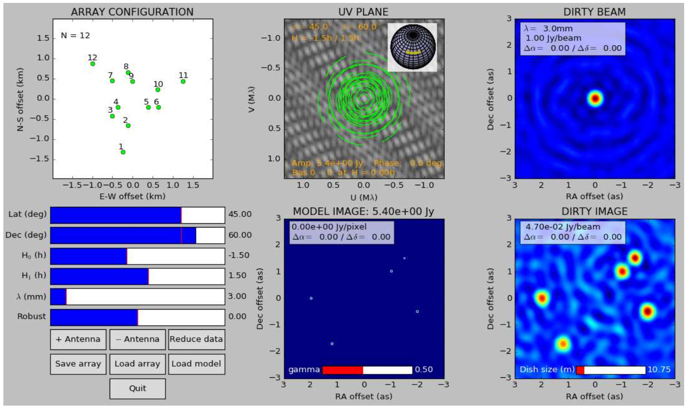
APSYNSIM
APerture SYNthesis SIMulator for Radio Astronomy, by I. Marti-Vidal, is a Python-based interactive tool that allows the users to perform Aperture Synthesis:
load many different interferometer arrays and source models
change the observing conditions such as source coordinates, observing wavelength, antenna location, integration time
deconvolve the interferometric images via the CLEAN algorithm
corrupt the data with with antenna-based and/or baseline-based gain errors (in both amplitude and phase)
Main window of APSYNSIM: five compact sources observed with a 12 elements Golay array

Slide 9
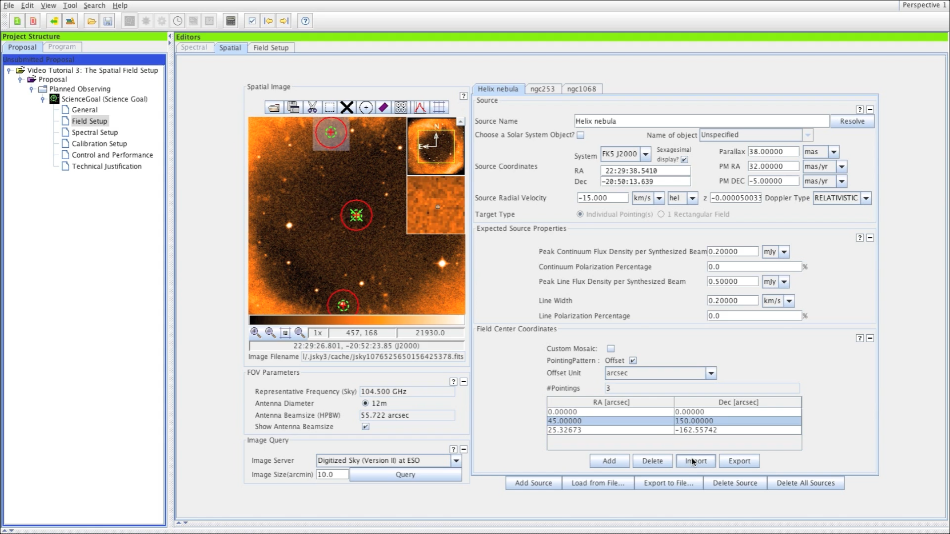
ALMA OT
The ALMA Observing Tool (OT) is a Java desktop application used for the preparation and submission of ALMA Phase 1 proposals and Phase 2 materials.
The Science Goal(s) contains all the project technical specifications divided in six nodes:
General
Field Setup
Spectral Setup
Calibration Setup
Control and Performance
Technical justification
Once completed, the project must be
validated and submitted to the ALMA
Archive
OT main GUI

Slide 10
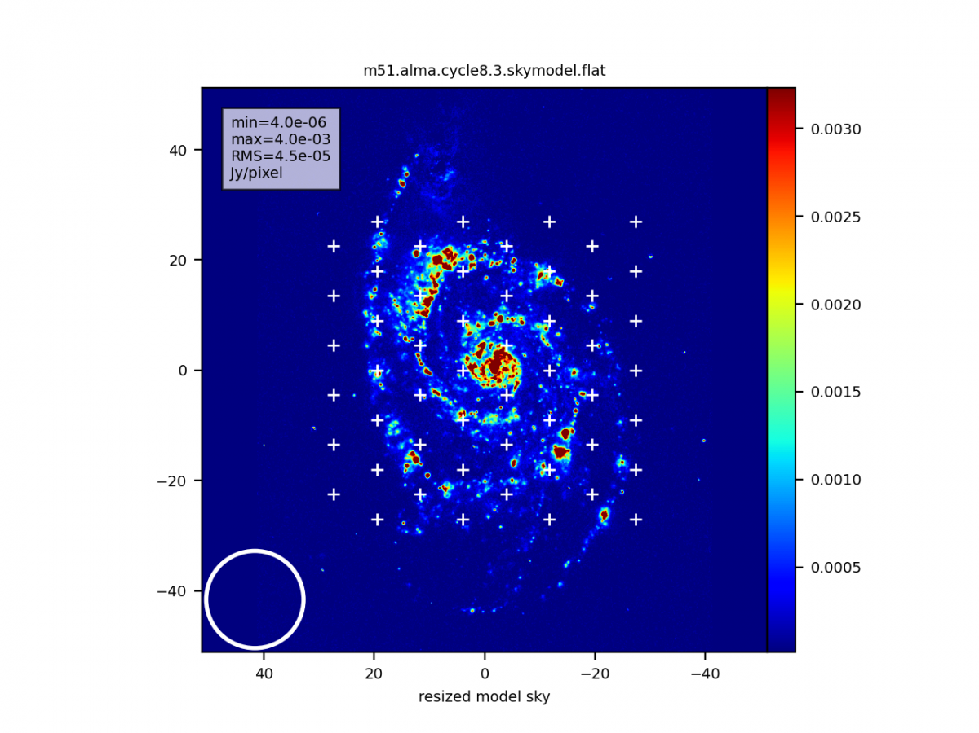
CASA
CASA, the Common Astronomy Software Applications package, can process data from both single-dish and aperture-synthesis telescopes, is the primary data processing software for ALMA, and supports the data reduction and imaging pipelines for ALMA and VLA.
Moreover CASA simulator enables users to simulate observations using any or all of ALMA components, generating visibilities and images for each array and then combining all the uv data to form the final image.
If the region of interest is larger than the primary beam, the pipeline need to mosaic many interferometric pointings
hexagonal mosaic overplotted on sky model

Slide 11
References
https://casaguides.nrao.edu/
https://almascience.eso.org/
https://launchpad.net/apsynsim
https://almascience.nrao.edu/
https://www.almaobservatory.org
Wilson, Rohlfs, Huttemeister, Tools of Radio Astronomy, Springer

